Slide 1


Slide 2
LevelUp
Beyond the standard questions.
ML System Design
Team:
Giorgi Kurtanidze
Raúl Ernesto Guillén Hernández
2024
Notes:
overview of the course, instructors
links to materials

Slide 3
Overview
What is the project about?
Overview
LevelUp streamlines the technical interview process by using generative AI to create unique, topic-specific problems at varying difficulty levels, addressing the challenge of candidates rehearsing common interview questions and providing a more effective and reliable evaluation of abilities.
ML System Design patterns
Retrieval Augmented Generation (RAG)
References
https://www.mermaidchart.com/app/projects/8ec149e2-92c2-4eec-b298-16b78c7e7db6/diagrams/64779d29-04f6-4a31-8df9-d2cc33fffef5/version/v0.1/edit
https://huggingface.co/datasets/DenCT/codeforces-problems-7k

Slide 4
ML Product Design
Interviewers struggle to assess skills due to rehearsed solutions.
Unique question creation is time-consuming and hard to scale.
The current technical recruitment process is highly predictable; candidates memorize solutions, hindering assessment of true problem-solving ability.
Inputs will include parameters like desired topic (e.g., "Graph Theory"), difficulty (e.g., "Medium")
Save Time: Generate unique problems instantly.
Improve Assessment: Assess problem-solving skills, not memorization.
Ensure Fairness: Provide standardized, unique challenges.
Web-based, generates complete problem statements.
Problem description, constraints, sample input/output.
Technical Interviewers.
Hiring Managers.
Lead Engineers.
Problem Statement
Methodology
Value
Proposition
Solution
Customers
Conduct a beta program with hiring managers to use problems in live interviews and provide feedback.
Interface: Simple, intuitive with clear input fields for parameters.
Generation: Single-click button produces problem in clean, easy-to-read format.
Validation
App/UI/UX
Cost per token/call to the generative model API.
Hosting cost for the vector database.
Cost of servers for the backend and MLOps pipelines.
LLM as a Judge: Topic_relevance, difficulty_accuracy
LLM observation: problem_attempts, code_attempts
Time reduction during interview preparation.
Cost.
Number of problems generated per week/month.
Traffic in the platform.
Cost Structure
Performance / ML Metrics
🎯
Business Metrics (Success)

Slide 5
ML System Design - Production
Data source: The evanellis/codeforces_with_only_correct_completions in huggin face dataset will be used.
Data processing: Metadata will be stored in PostgreSQL, and embeddings in Vectorial Database for semantic retrieval.
Orchestrated schedule data scraping for an automated and continuous MLOps pipeline will add data to the dataset.
Inputs will include parameters like desired topic (e.g., "Graph Theory"), difficulty (e.g., "Medium")
RAG (Retrieval Augmented Generation) will be used, combining keyword and semantic (Vectorial) search for problem retrieval.
A LLM will generate new and unique problems based on retrieved examples and specified topic/difficulty.
Web-based, generates complete problem statements.
Problem description, constraints, sample input/output.
Online / Real-time Serving
Methodology
Methodology
Model Development
Solution
Data Engineering
Solution
Deployment & Serving
Conduct a beta program with hiring managers to use problems in live interviews and provide feedback.
Interface: Simple, intuitive with clear input fields for parameters.
Generation: Single-click button produces problem in clean, easy-to-read format.
Validation
App/UI/UX
Validation
App/UI/UX
Databases -PostgreSQL for metadata and a Vector DB for embeddings.
Embedding Model
Generator Model (LLM)
LLM as a Judge: Topic_relevance, difficulty_accuracy
LLM observation: problem_attempts, code_attempts
Monitoring includes performance; a separate LLM will verify the main LLM's output.
Traceability and Evaluation database stores requests, retrieved problems, prompts, generated problems metrics.
🎯
Infrastructure / Resources
Performance / ML Metrics
🎯
Testing & Monitoring
Performance / ML Metrics

Slide 6
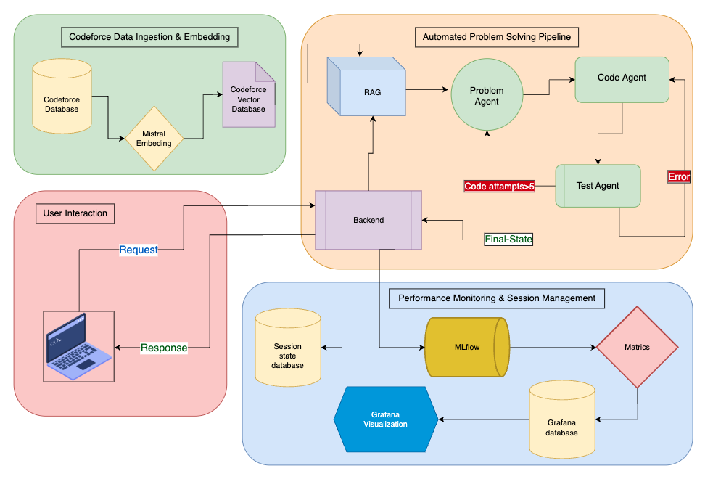
ML System Architecture Diagram: LevelUp

Slide 7
Guiding MLOps principles: LevelUp
🏗️ Infrastructure as Code
Containerized Architecture: Docker Compose orchestration
Multi-service Setup: Backend, Frontend, MLflow, Grafana
CI Pipeline: GitHub Actions with 6 parallel jobs
📊 Experiment Tracking & Model Management
MLflow Integration: Centralized experiment tracking
Automated Logging: mlflow.langchain.autolog()
Custom Metrics: Topic relevance, difficulty accuracy
Data Versioning & Management 📂
DVC Integration: Version-controlled datasets
Structured Pipelines: data_ingestion.py & preprocessing
Real-time Monitoring 📈
Grafana Dashboards: Performance visualization
ML Pipeline Observability: End-to-end tracking

Slide 8
🔄 CI/CD Automation – Production-ready deployment pipeline
🧪 Enhanced Testing – Conduct a beta program with hiring managers
📊 User Feedback Collection – Ratings, relevance, difficulty, interaction tracking
🤖 Custom Model Training – Fine-tuning with user data, A/B testing, auto-retraining
🚀 Next Steps:

